Slide 1


Trends and climate of US Breweries
A report prepared by Tajar, Inc.
Rajat Chandna, Andy Ho, An Nguyen, Jodi Pafford, and Tori Wheelis

Slide 2
The TAJAR, Inc Team:
Rajat Chandna
Andy Ho
An Nguyen
Jodi Pafford
Tori Wheelis

Slide 3
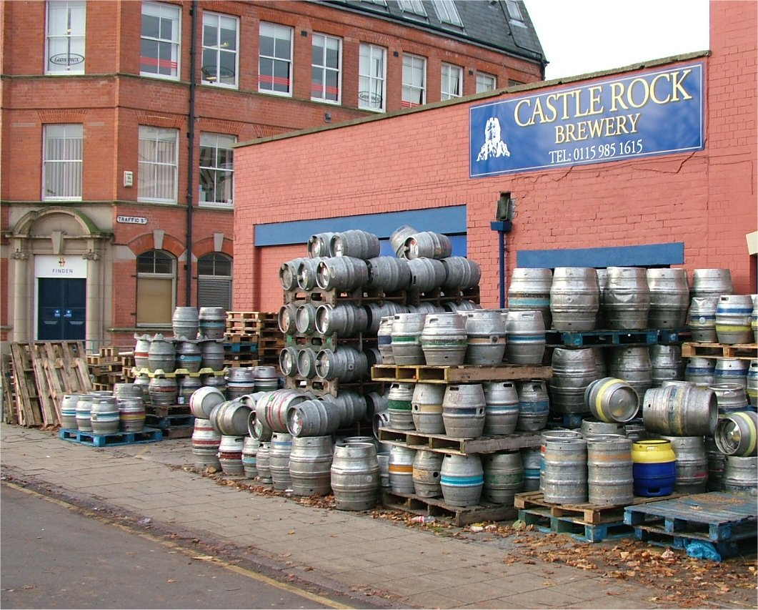
The Brewery File:
Data File with Brewery Information
This Photo by Unknown Author is licensed under CC BY-SA

Slide 4
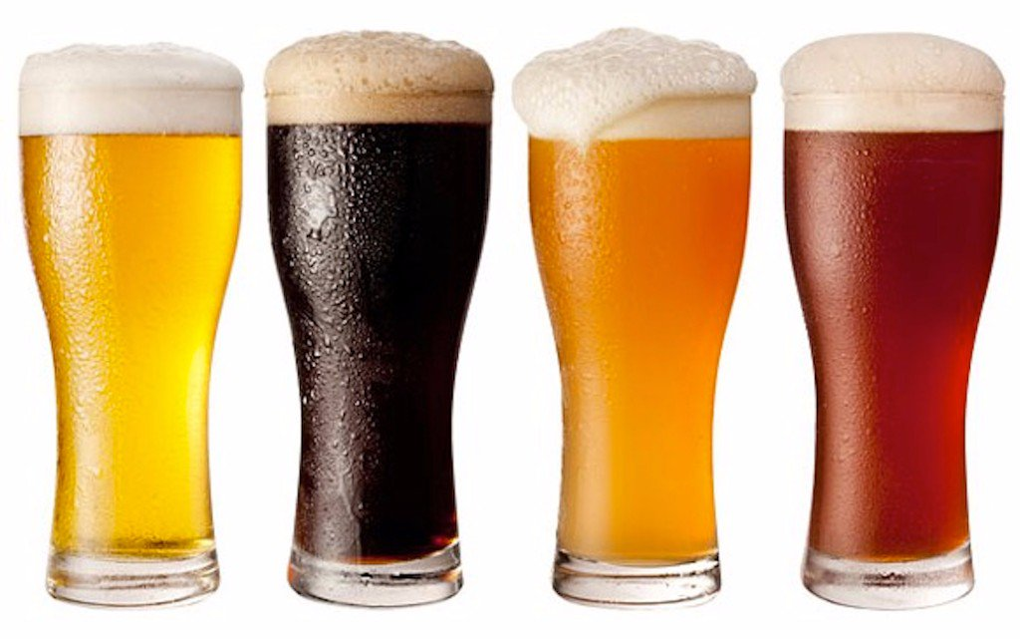
The Beers File:
Original file has 2,410 lines of data
Removal of obvious duplicates
Search beginning and ending strings
Prepare File for Merging
Final File, CleanedBeerData, used to merge, contains 2,366 different types of beer
This Photo by Unknown Author is licensed under CC BY-NC-ND

Slide 5
Example of Data
Insert Data for Question 2 – Print the first 6 observations and the last 6 observations.

Slide 6
Further Discoveries:
Insert data for question 3 – How many N/As are in each column

Slide 7
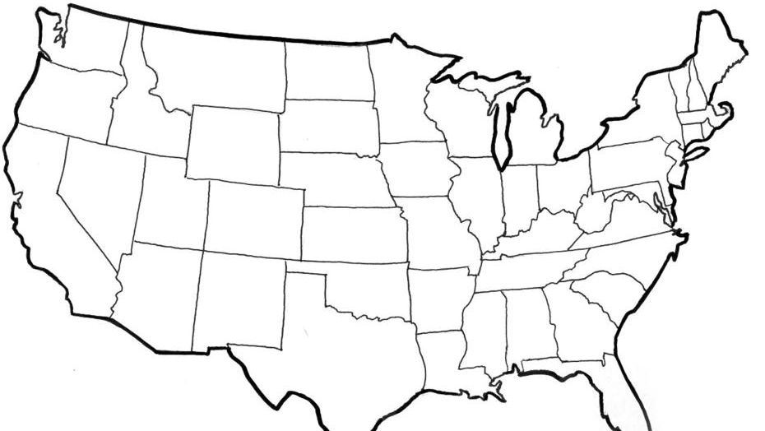
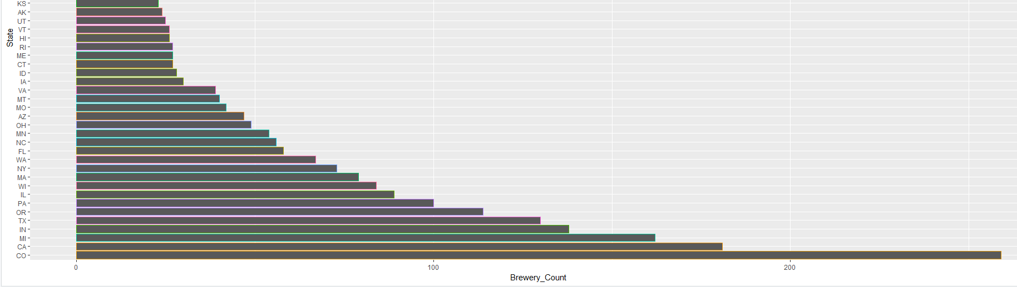
US Brewery Locations
This Photo by Unknown Author is licensed under CC BY-SA

Slide 8
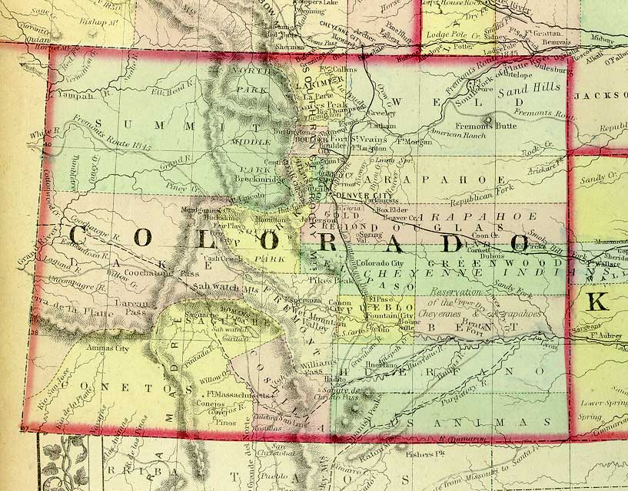

Maximum ABV
12.5% ABV
This Photo by Unknown Author is licensed under CC BY-NC-SA

Slide 9
Other Notable Information about ABV
Bottom 6 Max ABV’s per State
Delaware- 5.5%
Arkansas- 6.1%
Tennessee- 6.2%
New Hampshire- 6.5%
North Dakota- 6.7%
West Virginia- 6.7%
Top 6 Max ABV’s Per State
Colorado- 12.8%
Kentucky- 12.5%
Indiana- 12.0%
New York- 10%
Wisconsin- 9.9%
Texas- 9.9%

Slide 10
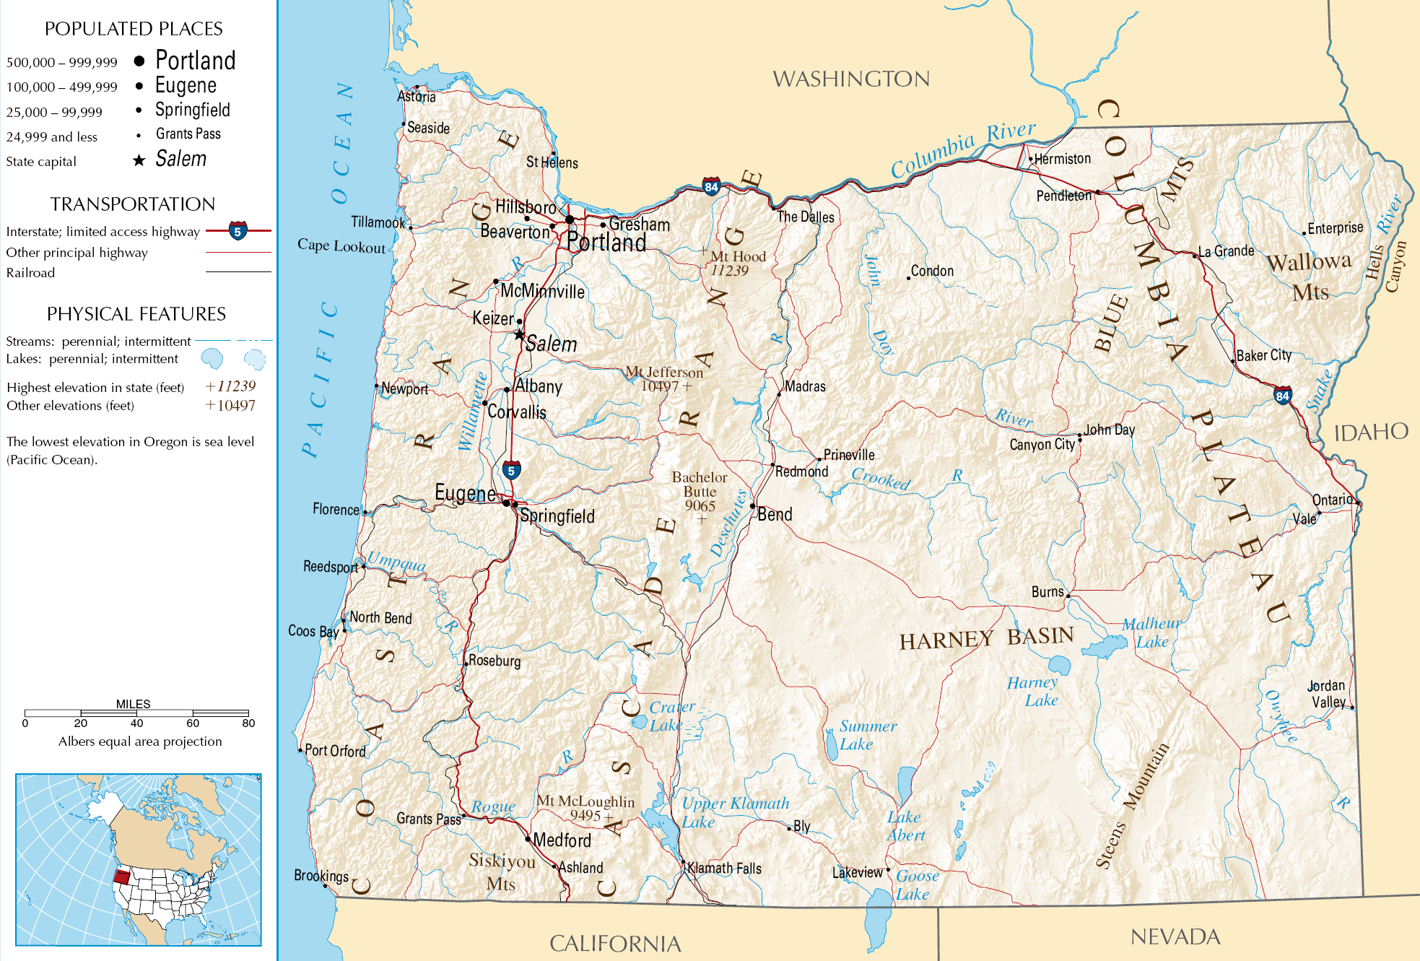

Most Bitter (IBU)
138 IBU
This Photo by Unknown Author is licensed under CC BY-SA

Slide 11
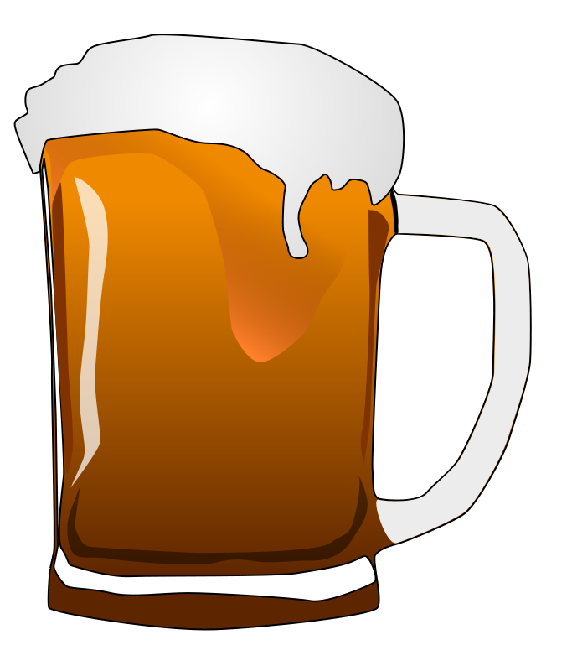
Median Alcohol Content & International Bitterness Units
Top 5 Highest Median IBU’s Per State:
Maine (61)
West Virginia (57.5)
Florida & Georgia (55)
Oregon (54)
Lowest 5 Median IBU’s Per State:
Wisconsin and Kansas (20)
Arizona (20.5)
Wyoming (21)
Hawaii (23)

Slide 12
Median Alcohol Content & International Bitterness Units
Wide range of ABV’s
5.5% (Delaware) to 12.8% (Colorado)
After New York, the next 13 state’s ABV’s are 9.9%
A sizable portion of the beers in the dataset have an ABV at or around 9-10%
The median of the median ABV’s is 9%
The median of the median ABV’s in each state is 9%
The third quartile of the median ABV’s in each state is 9.9%

Slide 13
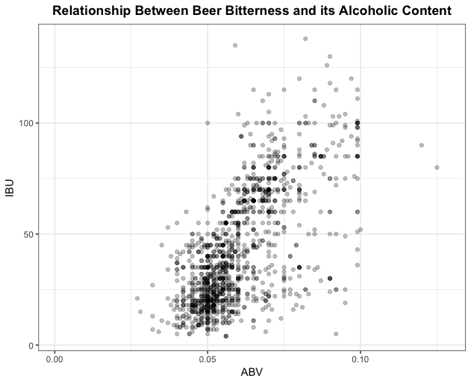
IBU vs ABV Relationship?

Slide 14
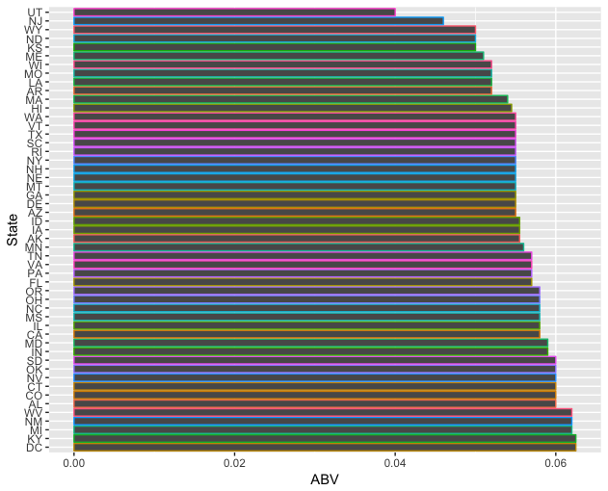
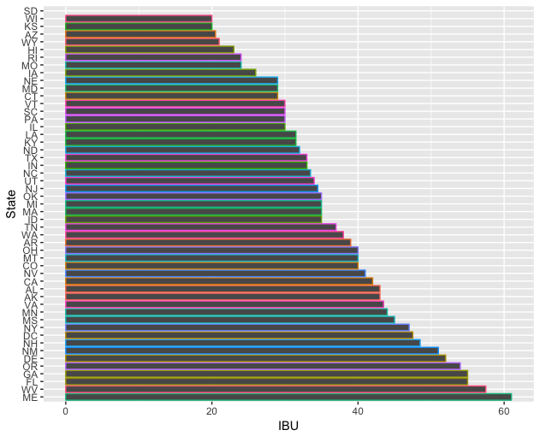
Median IBU and ABV’s per state

Slide 15

Questions?

Slide 16
Thank You for allowing us to partner with you

